Slide 1
Basic Computing Curriculum
Session 7: Basic Computer Security
Notes:
Welcome to Session 3 of our course. In this presentation, we will cover the basics of Internet Navigation, including what is the internet, web browsers, searching for information online, and internet security and privacy.

Slide 2
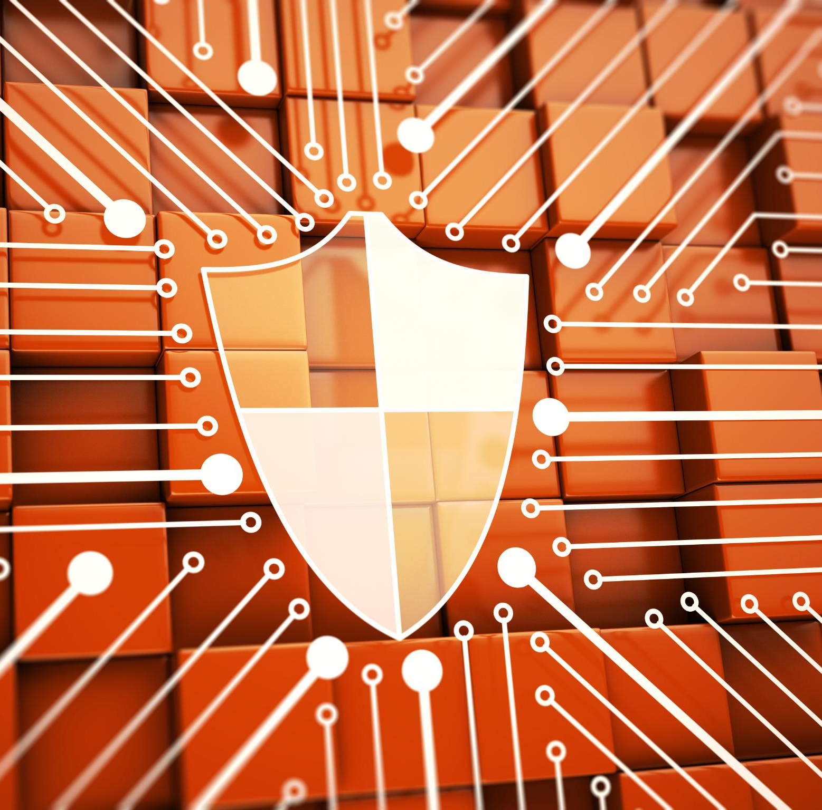
Presentation Overview
Introduction to Computer Security
  In this section, we will introduce the concept of computer security, why it is important and the risks and vulnerabilities associated with it.
Threats to Computer Security
  In this section, we will explore the main threats to computer security, such as viruses, spyware, adware, and social engineering, and how to protect against them.
Password Security Best Practices
  In this section, we will discuss password security best practices, such as creating strong passwords, managing passwords, and using two-factor authentication.
Antivirus and Firewalls
  In this section, we will discuss the importance of antivirus and firewalls in computer security and how to choose and use them effectively.
Basic Online Privacy Concepts
  In this section, we will explore basic online privacy concepts and how to protect your privacy online.
Notes:
In this presentation, we will start by introducing the concept of computer security and explaining why it is important. Then, we will explore the main threats to computer security and how to protect against them. We will then delve into password security best practices, antivirus and firewalls, and basic online privacy concepts.

Slide 3
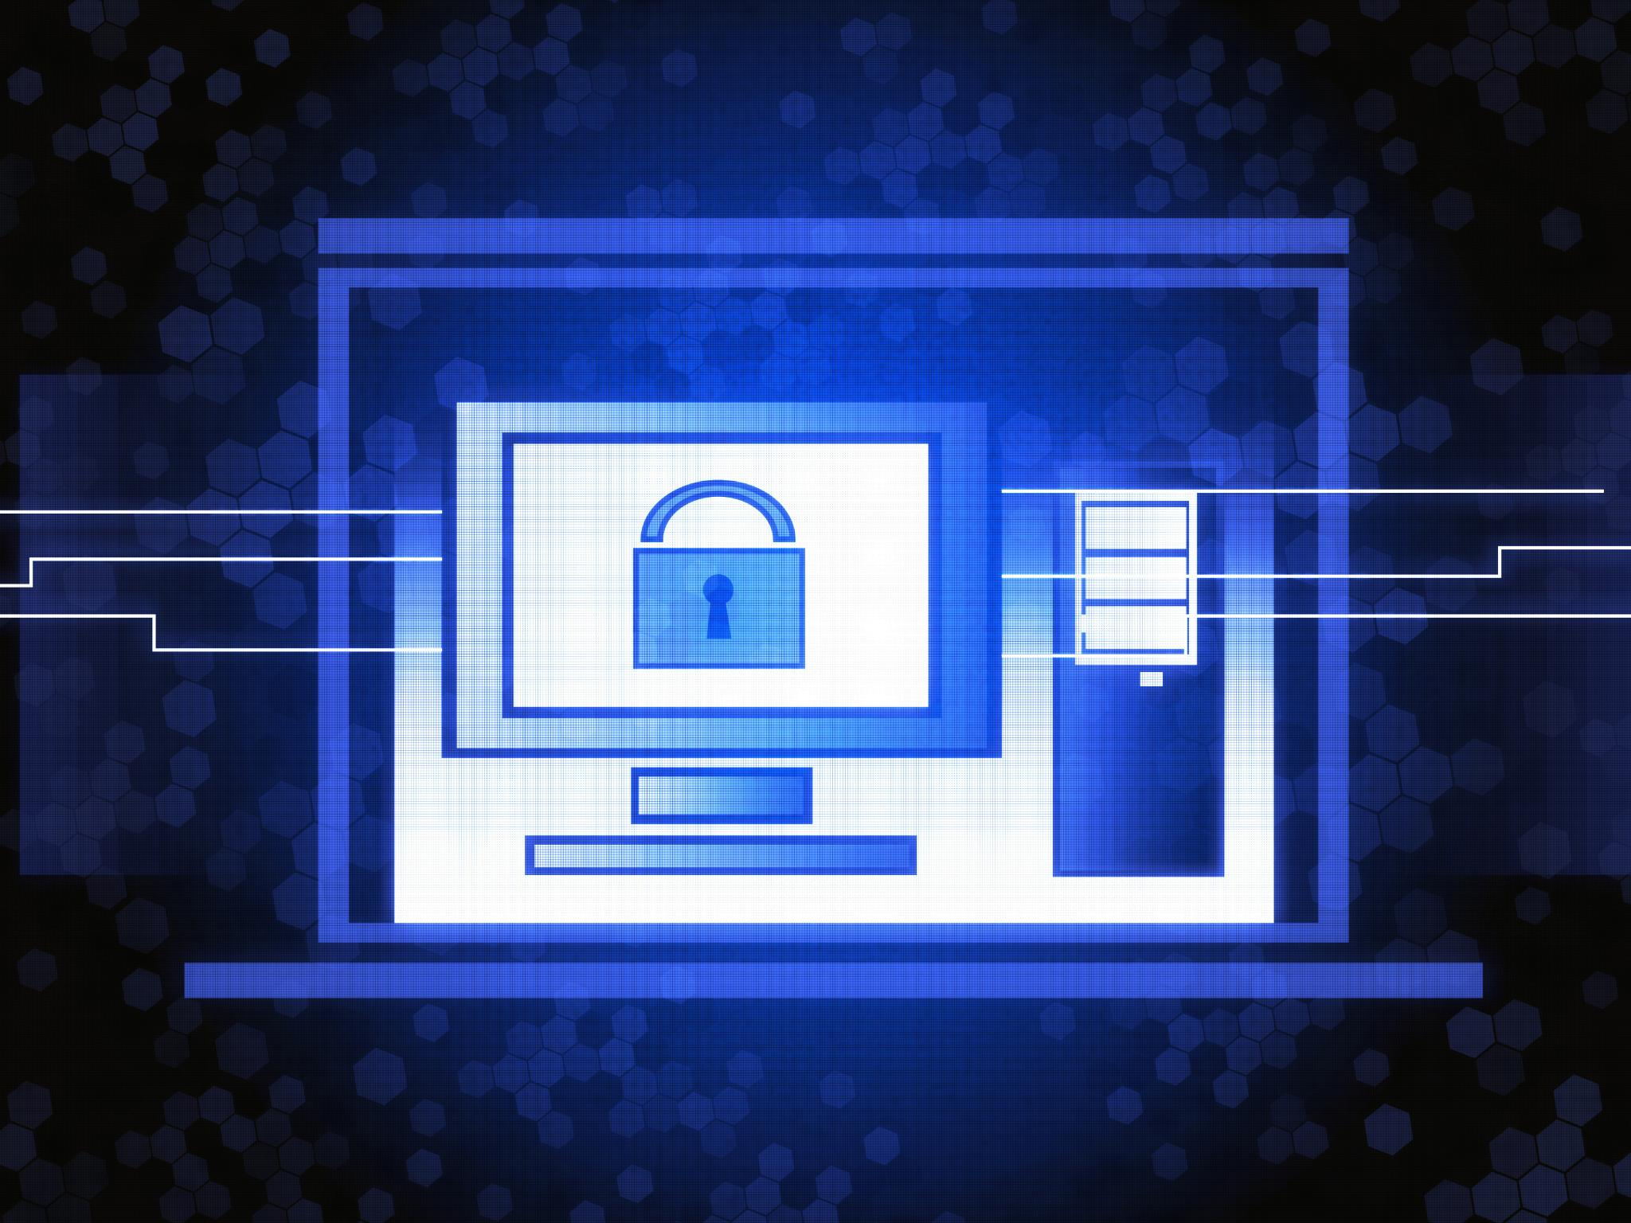
Introduction to Computer Security
  Computer security is important because it protects computer systems and networks from unauthorized access, theft, damage, and other malicious activities. It can help prevent data breaches and protect personal information.
Notes:
Computer security is the practice of protecting computer systems and networks from unauthorized access, theft, damage, and other malicious activities. We will discuss why computer security is important and how it can help protect personal information.

Slide 4
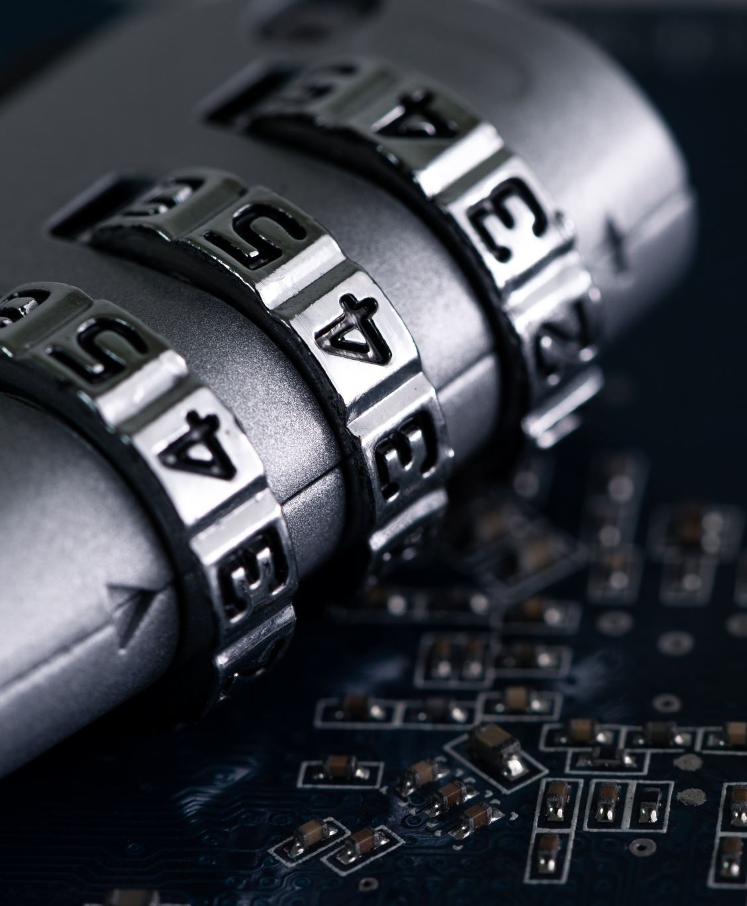
Main Threats to Computer Security
Viruses
  Viruses are malicious software programs that can infect your computer and cause damage to your files and hardware. They can spread through email attachments, file downloads, and infected websites.
Malware
  Malware is a broad term that includes viruses, spyware, adware, and other malicious software programs. They can cause harm to your computer system and steal sensitive information such as passwords and credit card details.
Phishing Attacks
  Phishing attacks are attempts to trick you into providing sensitive information such as login credentials or credit card details by posing as a trustworthy entity in an electronic communication such as email, chat or a web page.
Notes:
The main threats to computer security include viruses, malware, and phishing attacks. We will explain what each of these threats is, how they work, and how to protect against them.

Slide 5
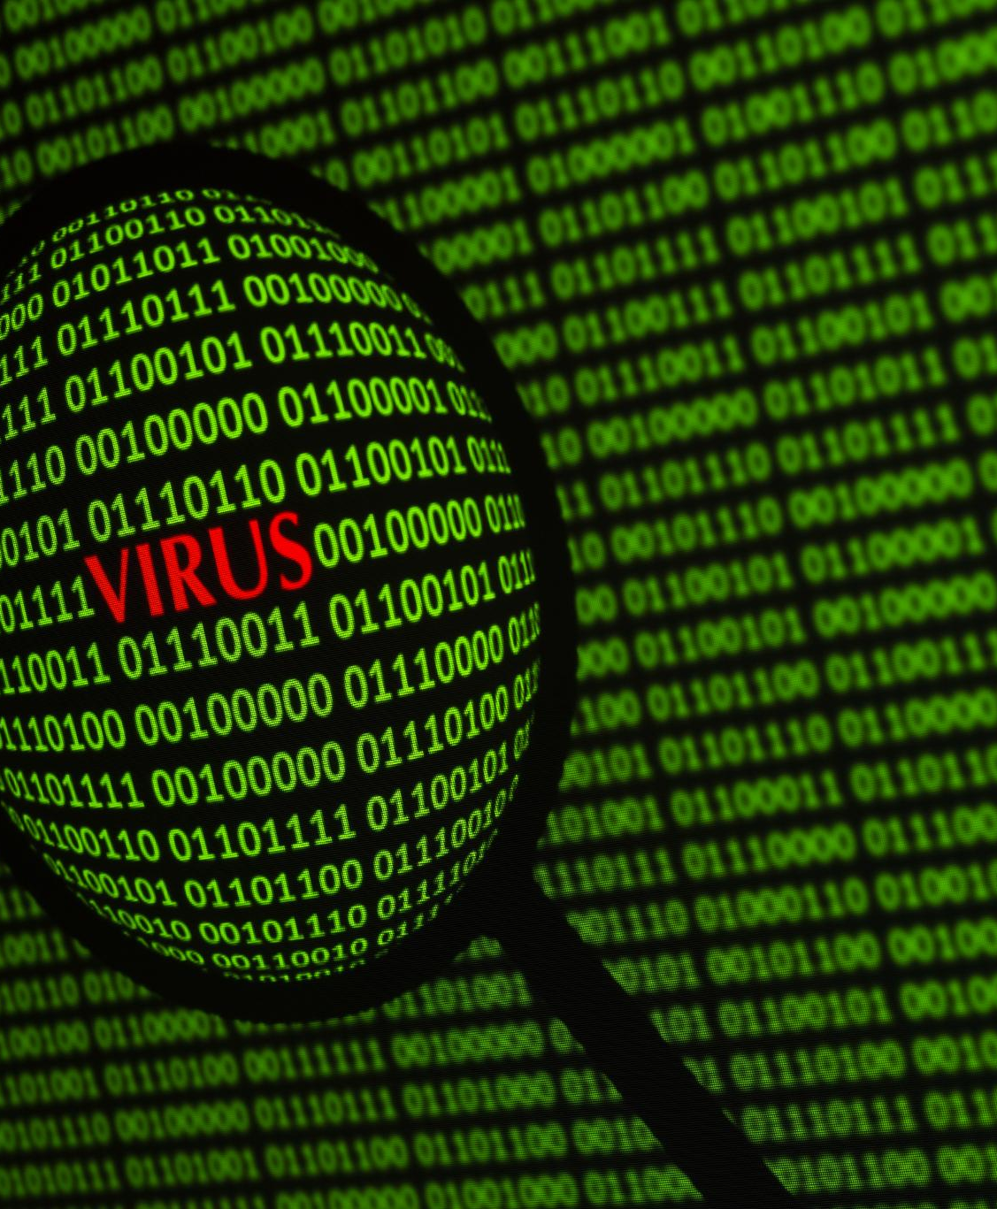
Viruses
Types of Viruses
  There are several types of computer viruses, such as file infectors, boot sector viruses, macro viruses, and more. Each type of virus behaves differently and requires a specific removal method.
Prevention Techniques
  There are several ways to prevent computer viruses, such as keeping your operating system and antivirus software up to date, avoiding suspicious email attachments and links, and downloading software only from trusted sources.
Virus Removal
  If your computer is infected with a virus, there are several ways to remove it, such as using antivirus software, restoring your system to a previous state, or reinstalling your operating system.
Notes:
A computer virus is a type of malware that can replicate itself and spread from one computer to another. We will discuss the different types of viruses and how they can be prevented or removed.

Slide 6

Malware
  Malware comes in many different forms, including viruses, worms, trojans, ransomware, and spyware. Each type of malware has a different method of attack and can cause varying degrees of damage to a computer system.
Notes:
Malware is a type of software that is designed to damage, disrupt, or take over a computer system. We will explore the different types of malware and how to detect and remove them.

Slide 7

Phishing Attacks
What are Phishing Attacks?
  Phishing attacks are a form of social engineering attack that use fraudulent emails, phone calls, or websites to trick people into divulging sensitive information, such as usernames, passwords, and credit card details.
How to Recognize Phishing Attacks?
  Phishing attacks often use deceptive techniques to appear legitimate, such as using company logos, email addresses, or phone numbers. Look out for suspicious requests for personal information or links to unfamiliar websites.
How to Avoid Phishing Attacks?
  To avoid phishing attacks, never click on suspicious links or download suspicious attachments. Instead, hover over links to see the URL and always verify the sender's email address or phone number before responding to requests for sensitive information.
Notes:
Phishing attacks are a type of social engineering attack that attempt to steal sensitive information, such as usernames, passwords, and credit card details, by posing as a trustworthy entity. We will explain how to recognize and avoid phishing attacks.

Slide 8
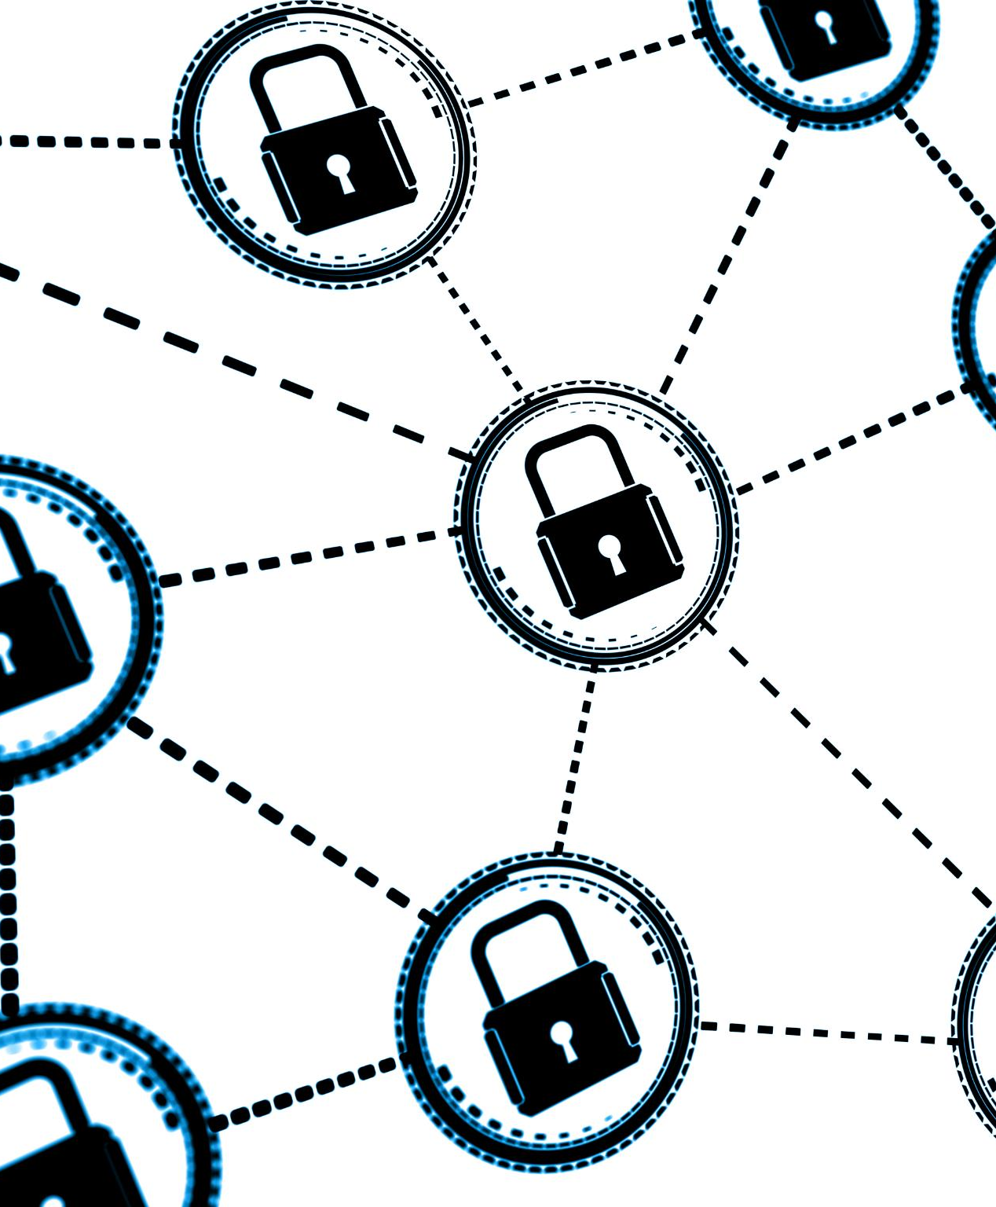
Password Security Best Practices
Password Best Practices
  Creating strong, unique passwords is the first step to protecting your personal information. Best practices include using a mix of uppercase and lowercase letters, numbers, and special characters, avoiding commonly used words or phrases, and never reusing passwords.
Password Managers
  Password managers are a great tool for creating and storing strong passwords. They can generate unique, complex passwords for each of your accounts and store them securely.
Two-Factor Authentication
  Two-factor authentication adds an extra layer of security to your accounts by requiring a code in addition to your password. This can be in the form of a text message, phone call, or app notification.
Notes:
Creating strong, unique passwords is one of the most important things you can do to protect your personal information. We will explore password security best practices and how to create strong passwords that are easy to remember.

Slide 9
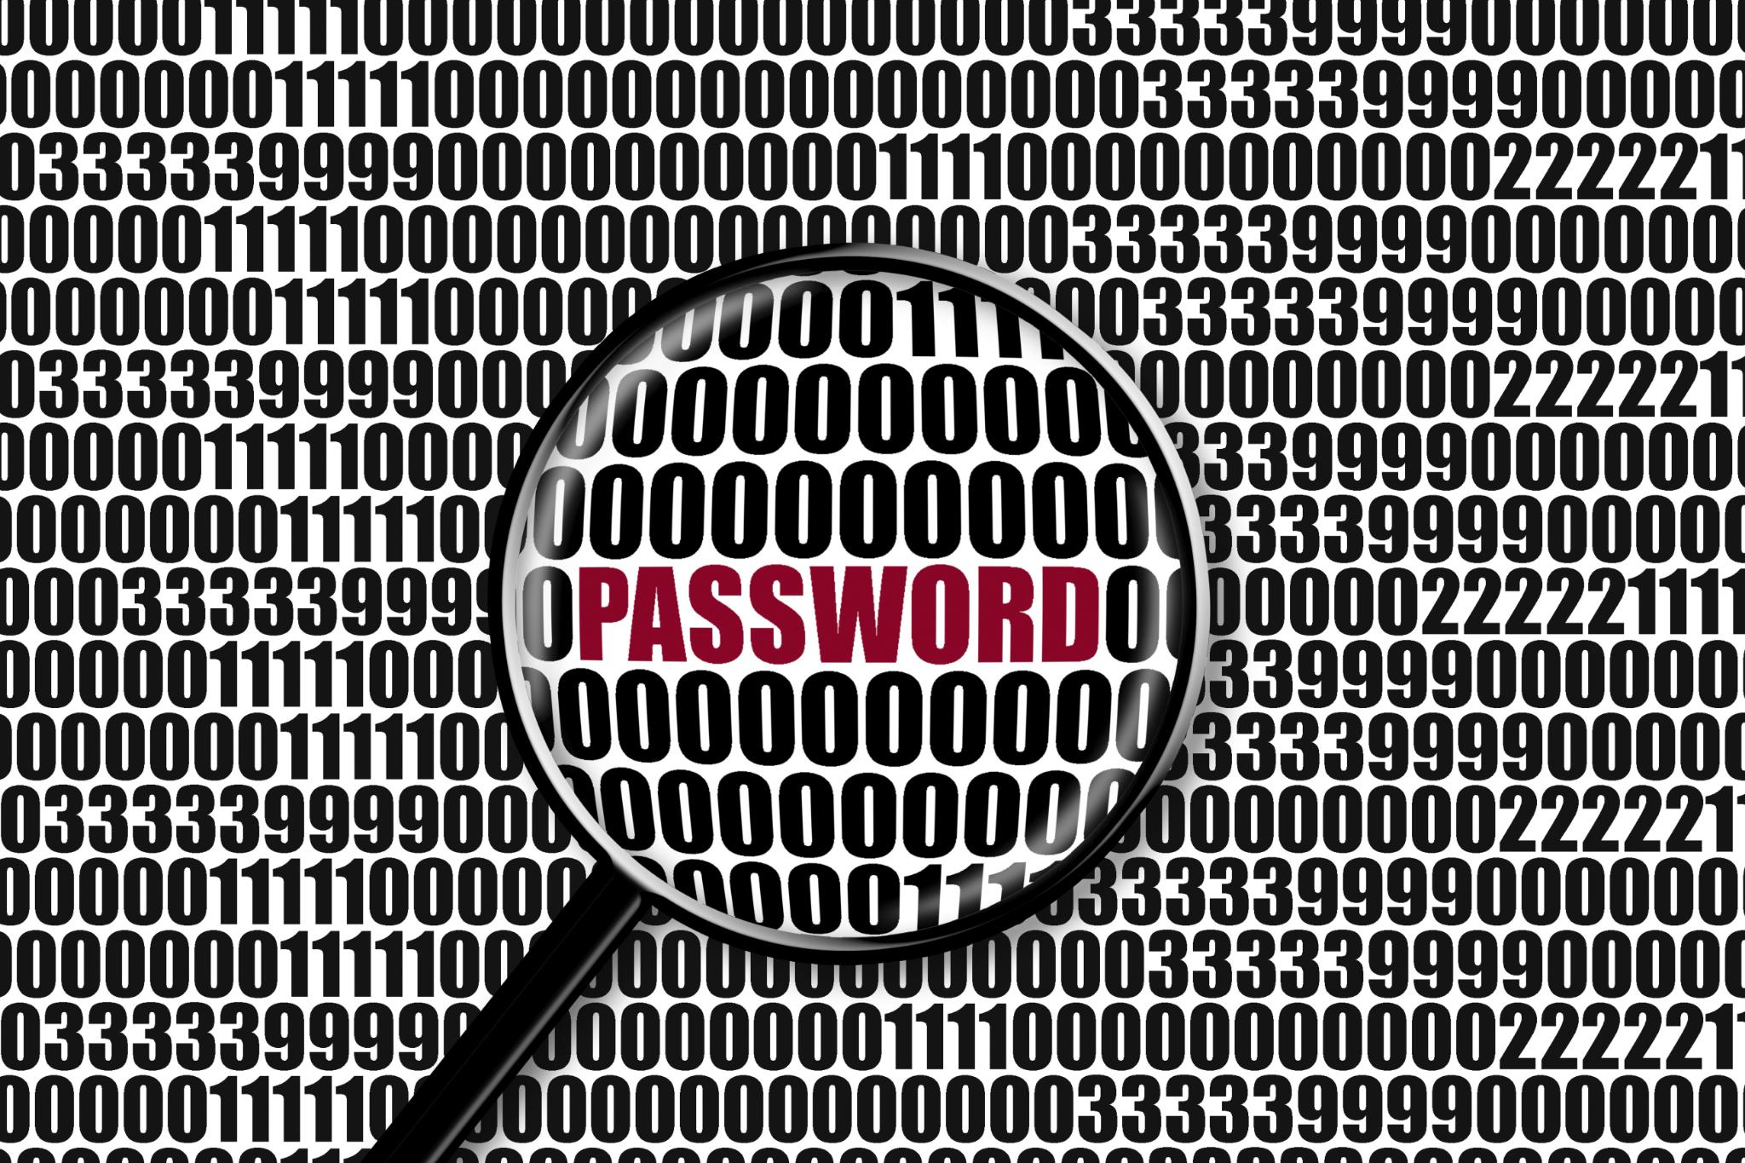
Creating Strong Passwords
  Creating strong passwords is essential for protecting your personal and sensitive information. Use a mix of upper and lowercase letters, numbers, and symbols. Avoid using common words and phrases, and never reuse passwords across different accounts.
Notes:
We will discuss some best practices for creating strong passwords, such as using a mix of upper and lowercase letters, numbers, and symbols, and avoiding common words and phrases.

Slide 10

Password Management Tools
Introduction to Password Management Tools
  Password management tools can help you create and manage strong passwords across multiple accounts, ensuring that your sensitive information remains secure.
Popular Password Management Tools
  Some popular password management tools include LastPass, Dashlane, 1Password, and Keeper. These tools can help you generate strong passwords, store them securely, and auto-fill passwords for you.
How to Use Password Management Tools
  To use a password management tool, you must first create an account and choose a master password. Then, you can generate and save strong passwords for your accounts.
Notes:
Password management tools, such as password managers, can help you create and manage strong passwords across multiple accounts. We will explore some popular password management tools and how to use them.

Slide 11
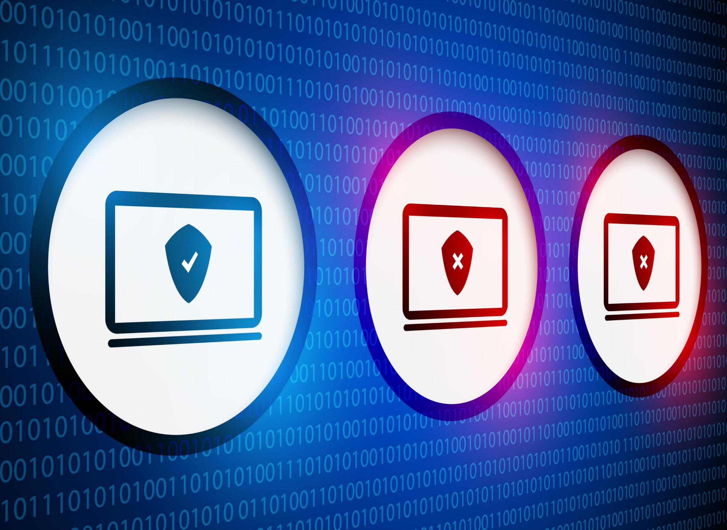
Antivirus and Firewalls
  Antivirus and firewalls are essential tools for protecting your computer against viruses, malware, and other threats. We will explain how these tools work and how to choose and use them effectively.
Notes:
Antivirus and firewalls are essential tools for protecting your computer against viruses, malware, and other threats. We will explain how these tools work and how to choose and use them effectively.

Slide 12
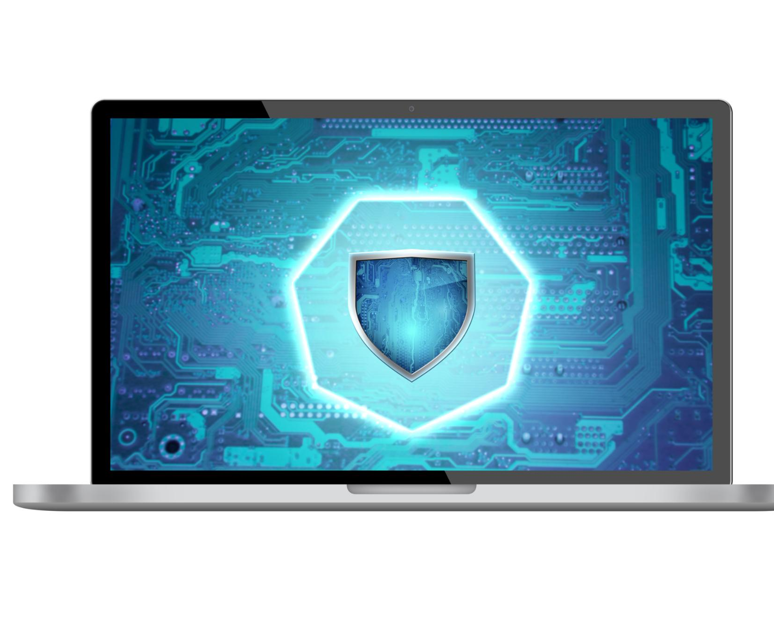
Antivirus Software
What is Antivirus Software
  Antivirus software is a program designed to detect and remove viruses and other malware from your computer. It scans your files and computer memory for malicious code and alerts you if it finds anything suspicious.
Popular Antivirus Software
  Some of the popular antivirus software include Norton, McAfee, Bitdefender, and Avast. These programs offer various features such as real-time scanning, firewall protection, and anti-phishing.
Notes:
Antivirus software is designed to detect and remove viruses and other malware from your computer. We will explore some popular antivirus software and how to use them.

Slide 13

Firewalls
What is a Firewall?
  A firewall is a network security device that monitors and controls incoming and outgoing network traffic based on a set of security rules. It acts as a barrier between a trusted, secure internal network and an untrusted outside network.
Choosing and Using Firewalls Effectively
  Choosing and using firewalls effectively is crucial for network security. It is important to select a firewall that meets the needs of your organization, configure it properly, and keep it patched and up to date to ensure maximum protection.
Notes:
A firewall is a network security device that monitors and controls incoming and outgoing network traffic based on a set of security rules. We will explain how firewalls work and how to choose and use them effectively.

Slide 14
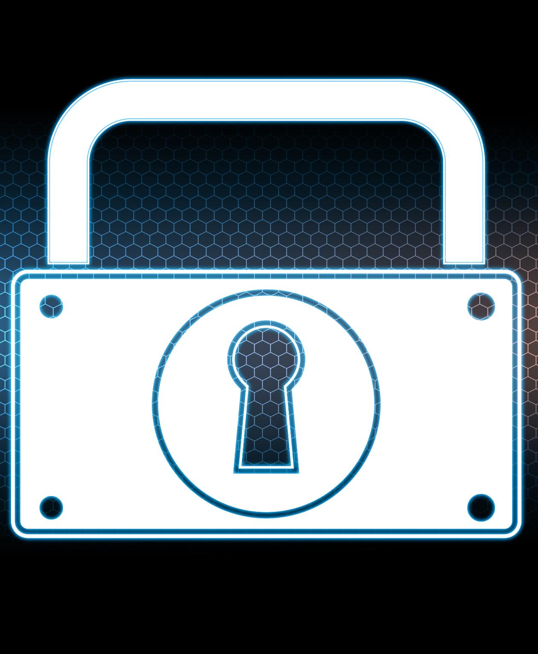
Basic Online Privacy Concepts
Why Online Privacy Matters
  Protecting your online privacy is important for keeping your personal information safe and secure. We will explore the reasons why online privacy matters and how it affects you.
Types of Online Privacy Risks
  There are various types of online privacy risks, including phishing scams, hacking, and malware. We will explore these risks and how to protect yourself from them.
How to Protect Your Online Privacy
  There are various ways to protect your online privacy, including using strong passwords, enabling two-factor authentication, and using a VPN. We will explore these methods in detail.
Notes:
Protecting your online privacy is important for keeping your personal information safe and secure. We will explore some basic online privacy concepts and how to protect your privacy online.

Slide 15
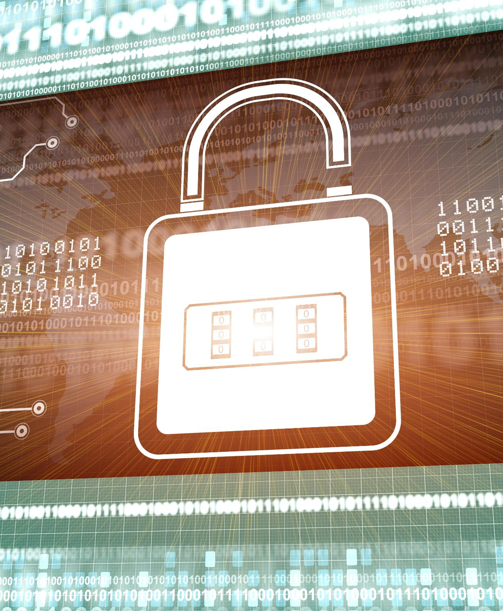
Online Tracking
What is Online Tracking
  Online tracking is the collection of data about your online activity, often for advertising or other purposes. It can include information about the websites you visit, your location, and your search history.
How Does Online Tracking Work
  Online tracking works by using cookies and other tracking technologies to collect data about your online activity. This data can then be used to create a profile of your online behavior and preferences.
Protecting Your Online Privacy
  There are several ways to protect your online privacy, including using a virtual private network (VPN) and regularly clearing your browsing history and cookies.
Notes:
Online tracking is the collection of data about your online activity, often for advertising or other purposes. We will explain how online tracking works and how to protect your online privacy.

Slide 16

Public Wi-Fi
Risks of Unsecured Public Wi-Fi
  Public Wi-Fi networks are often unsecured and can be vulnerable to hacking and other attacks, putting your personal data and privacy at risk.
Best Practices for Using Public Wi-Fi Networks
  Some best practices for using public Wi-Fi networks safely include avoiding sensitive transactions, using a VPN, and keeping your device's software up-to-date.
Notes:
Public Wi-Fi networks are often unsecured and can be vulnerable to hacking and other attacks. We will explore some best practices for using public Wi-Fi networks safely.

Slide 17

Practical Activity: Creating Strong Passwords
  Learn how to create strong passwords that are difficult to guess and provide an additional layer of security to your online accounts.
Notes:
We will now have a practical activity where you will learn how to create strong passwords and use password management tools effectively.

Slide 18
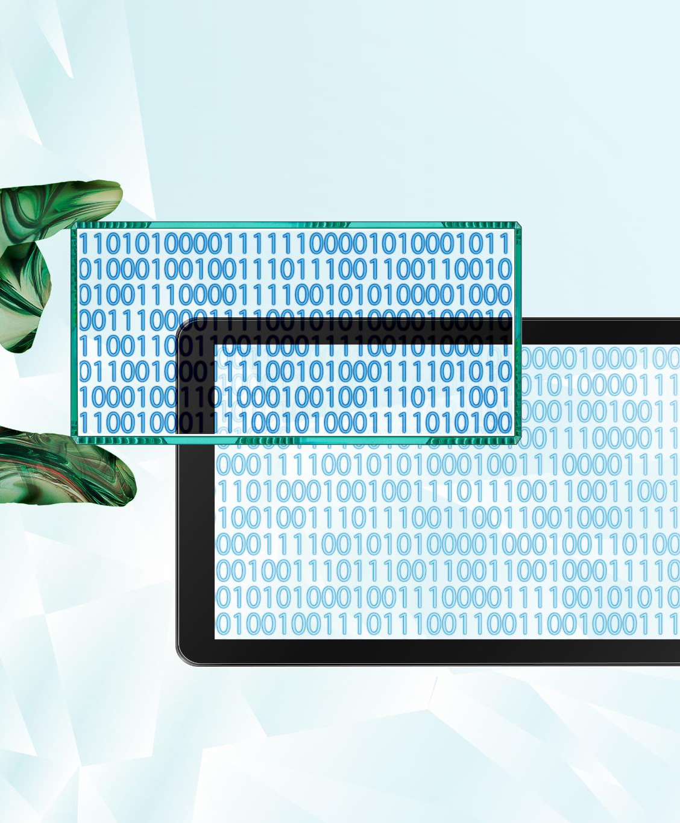
Practical Activity: Scanning a Computer with Antivirus Software
Introduction to Antivirus Software
  Antivirus software is a program designed to detect and remove viruses and other malware from your computer. It is important to have antivirus software installed on your computer to protect yourself from cyber threats.
Choosing an Antivirus Program
  There are many free and paid antivirus programs available on the market. It is important to choose a program that is reliable and regularly updated to ensure maximum protection for your computer.
Scanning your Computer
  To scan your computer for viruses and malware, you need to open your antivirus program and choose the option to perform a full system scan. This process may take some time depending on the size of your hard drive.
Notes:
We will now have another practical activity where you will learn how to scan your computer for viruses and other malware using a free antivirus program.

Slide 19

Conclusion
  By following best practices for password security, using antivirus and firewalls, and understanding basic online privacy concepts, you can help keep your computer and personal information safe and secure.
Notes:
In this presentation, we have explored the basic principles of computer security and how to protect personal information. By following best practices for password security, using antivirus and firewalls, and understanding basic online privacy concepts, you can help keep your computer and personal information safe and secure.

